Slide 1

TO LEAVE OR STAY?
Jeremy Dawkins

Slide 2

Attrition: Is it good or bad?
Several people have left the company for unknown reasons. Fear not, for an investigation will ensue to determine why! Was it because of money, job roles, or because of the environment? Could it have been a combination of these?

Slide 3
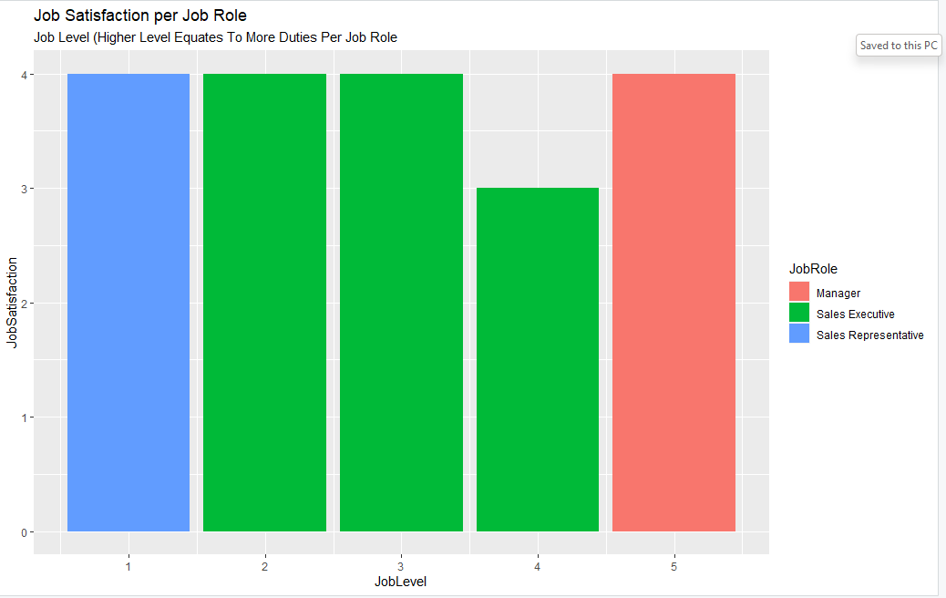
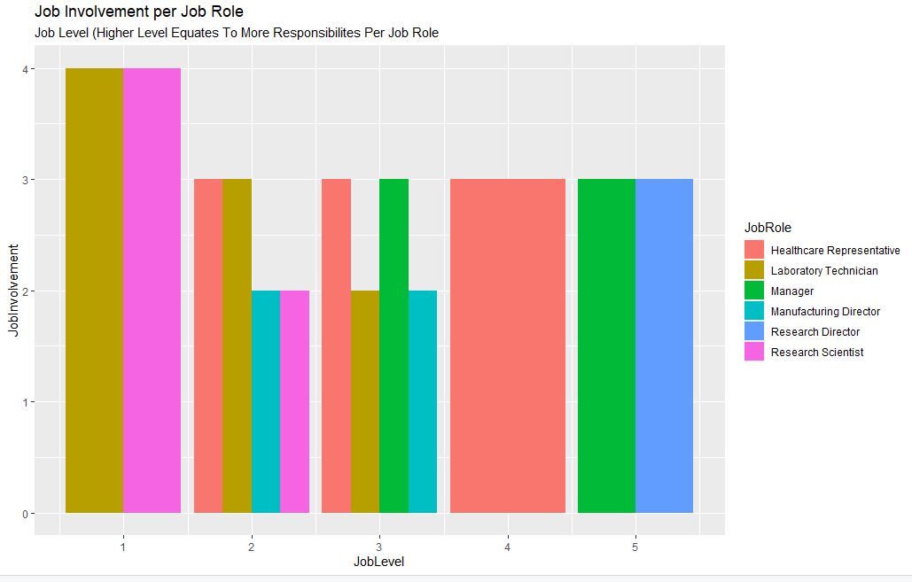
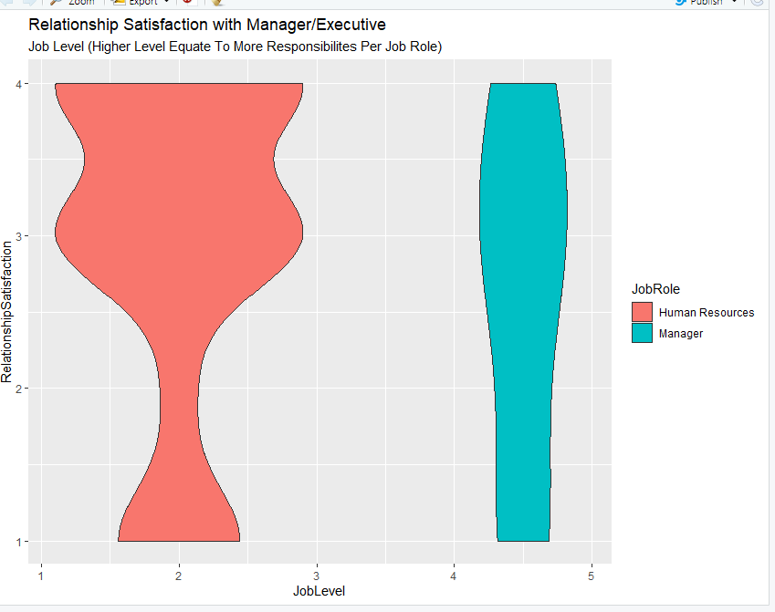
Department Examinations
Sales Department
R&D Department
HR
Department

Slide 4

Contributing Factors
After studying the sample, the identifiable attrition factors were job involvement, overtime, and marital status.
Why these?

Slide 5
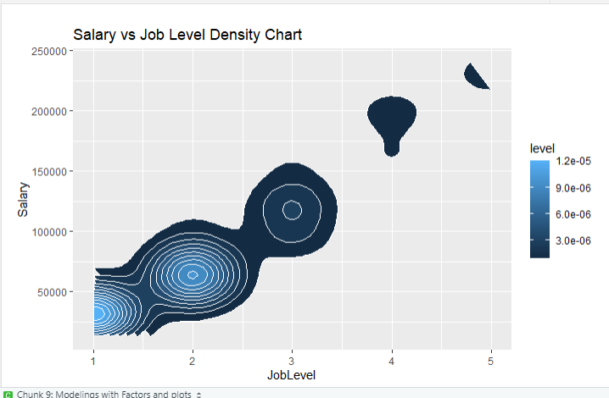
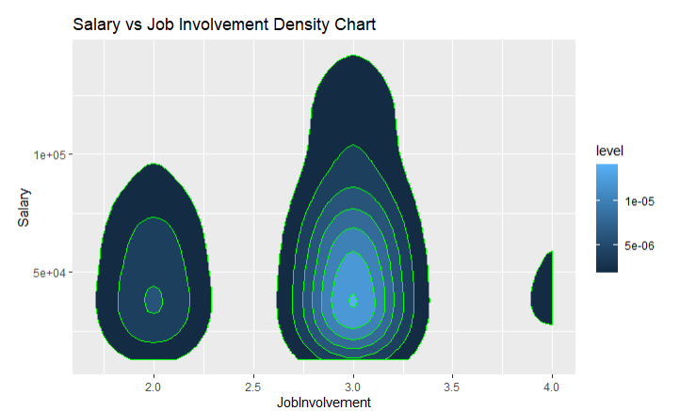
Factors of Salary
Job Level
Performance Rating
Job Involvement

Slide 6

Predictions
Is there a way to predict an employee’s likelihood for leaving based on certain criteria? Yes! A model with 84% accuracy has been created with 91% sensitivity and 60% specificity.

Slide 7

With these discoveries in mind, it is advised that the company focus on these areas of weakness and the influence behind low survey scores. Is it possible that former employees were merely poor performers or did the company’s lack of attention to employee needs cause this attrition.

